Slide 1
Hospital-Acquired Infections in new york state
A python project

Slide 2

Project Objectives
Find a dataset relevant to my current employer
Practice cleaning and enhancing the raw data to support analysis
Explore the data for actionable trends using a variety of visualization techniques
Notes:
This was a great learning experience. I had opportunities to try lots of things we hadn’t explicitly worked through, like setting up a virtual environment and installing several new Python libraries.

Slide 3
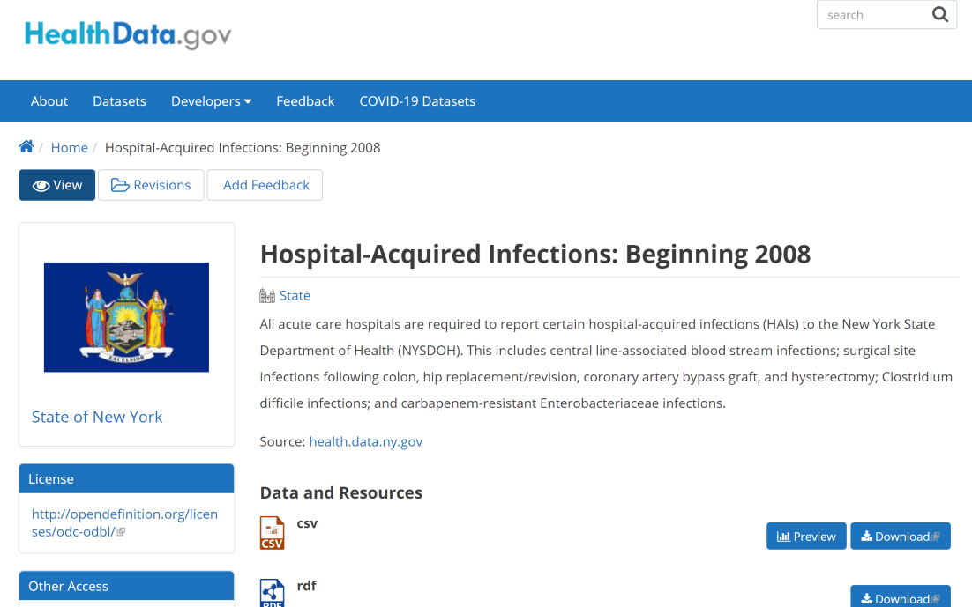
Data sources
https://healthdata.gov/dataset/hospital-acquired-infections-beginning-2008
https://healthdata.gov/dataset/hospital-acquired-infections-beginning-2008
Notes:
This dataset contained 21,661 rows

Slide 4
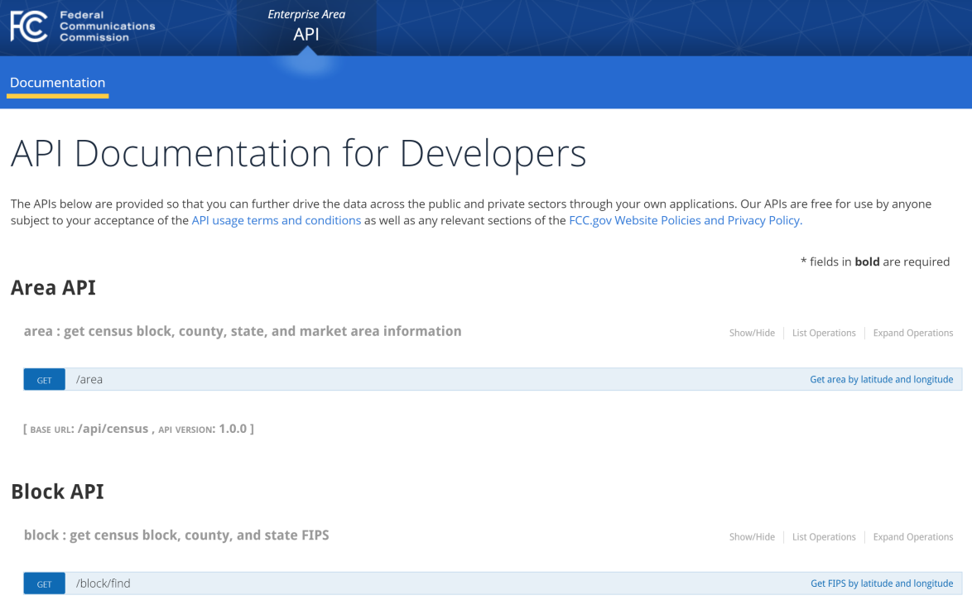
Data sources
https://healthdata.gov/dataset/hospital-acquired-infections-beginning-2008
https://geo.fcc.gov/api/census/
Notes:
I used this API to bring in the name and location of the county where each hospital facility was located. I had an idea that I wanted to see if infections were more likely to occur in certain parts of the state.

Slide 5
Data INCLUDED
Facility ID
Hospital Name
Geographic Location (Latitude, Longitude)
Year
Indicator Name
Infections Observed (total count)
Indicator Units
Indicator Value (calculated based on total count and units)

Slide 6
Data INCLUDED
API: County Name, County FIPS
Facility ID
Hospital Name
Geographic Location (Latitude, Longitude)
Year
Indicator Name
Infections Observed (total count)
Indicator Units
Indicator Value (calculated based on total count and units)
API: County Name, County FIPS
Indicator Code Indicator Area
SSI Hysterectomy
CDI Hospital Onset
CLABSI Pediatric ICU
Notes:
The infections dataset includes many records from the same facilities. To minimize API calls, I first created a set containing only the unique latitude and longitude combinations. This reduced the number of calls I would have to make from 21,422 to 197. Once I had the API data, I saved it into a separate csv file so I could just read it back in without having to re-do any API calls.

Slide 7
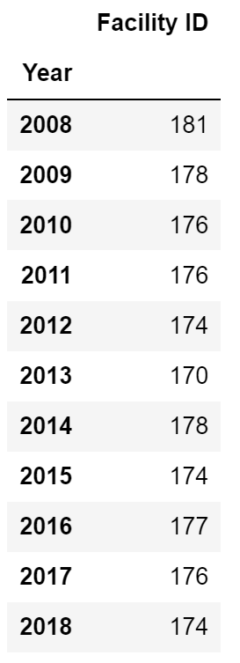
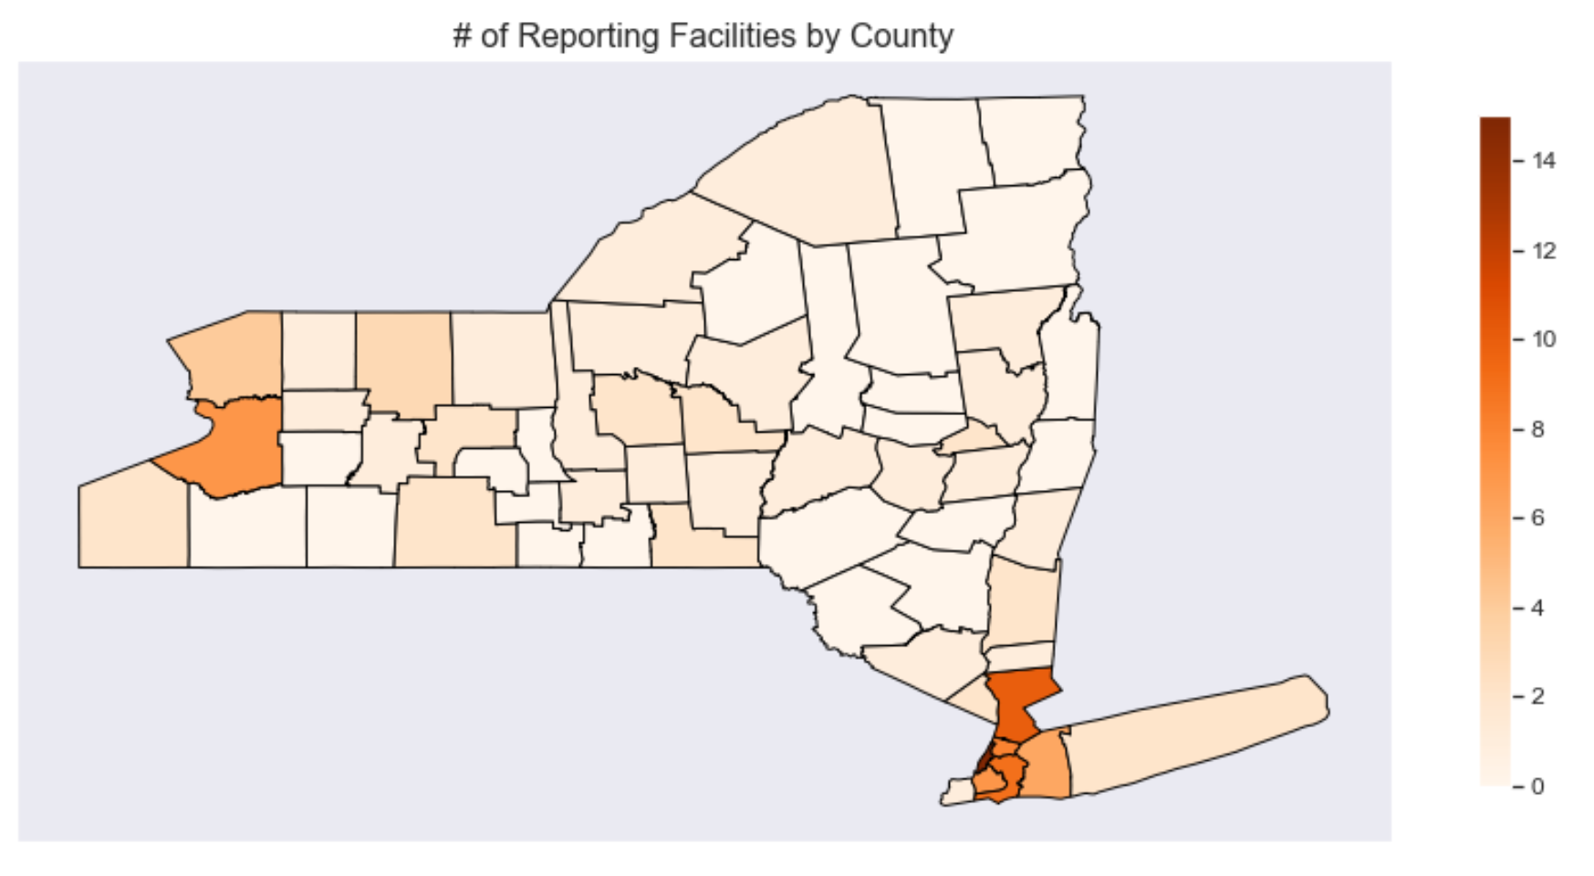
Data exploration
How many facilities reported each year?
How are they distributed around the state?
Notes:
First, I wanted to see how many facilities I had in my dataset and where they were located.
I found a Python library called “us” that had shapefiles for each of the states, so I imported the one for New York.
Then I needed to find libraries that could read the shapefile and map my data to each county (shapefile, geopandas, shapely).
The shapefile used the County FIPS code I got from the API.
It turns out that most of the facilities are near the NYC metropolitan area in the southeast corner of the state. The darker county to the west is Erie county.

Slide 8
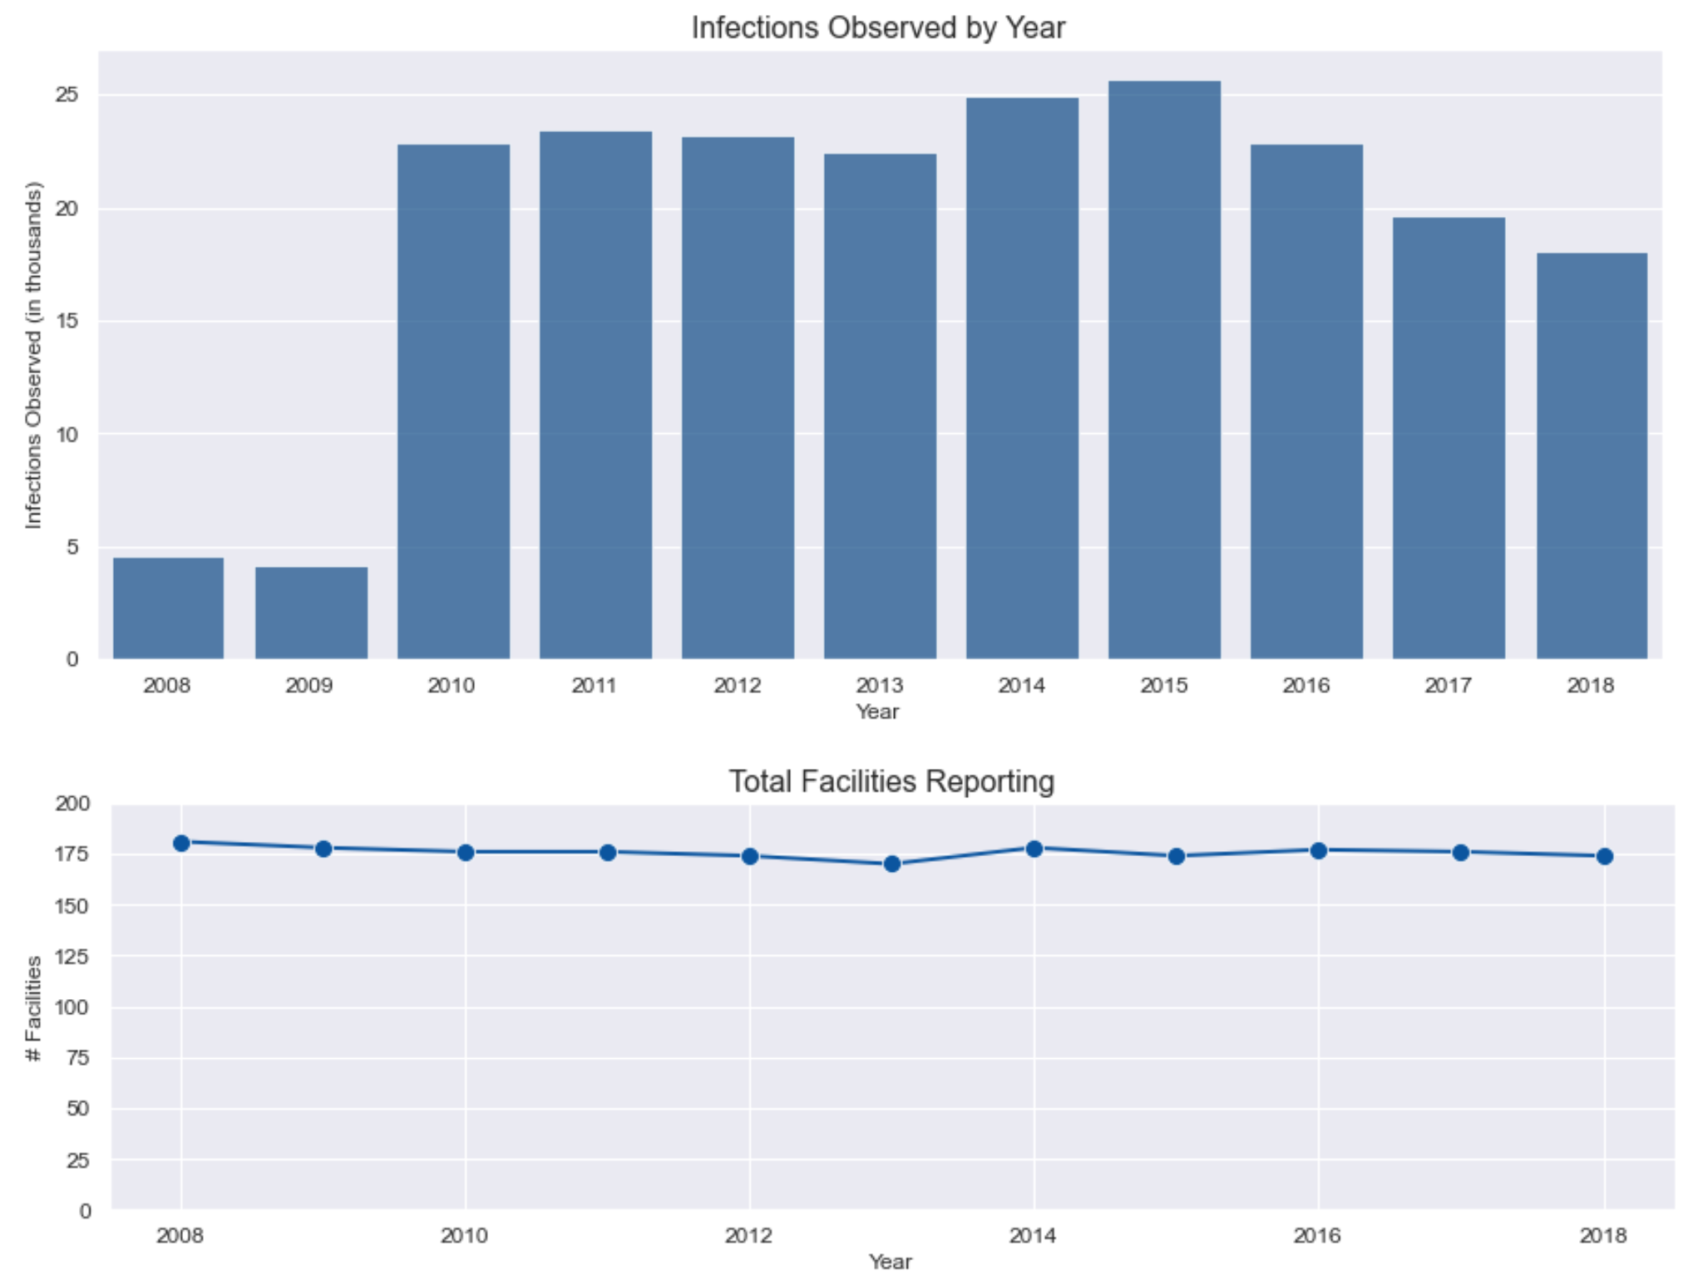
Data exploration
How has the number of observed infections changed over the past 11 years?
Notes:
Next I wanted to look for any large-scale trends in the number of infections observed over the years included in my dataset.
I noticed there was a big jump in the number of infections from 2009 to 2010, even though the number of facilities reporting data stayed about the same, so I decided to look into this a bit further.

Slide 9
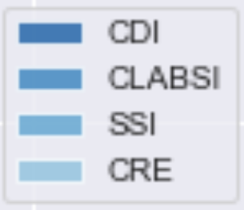
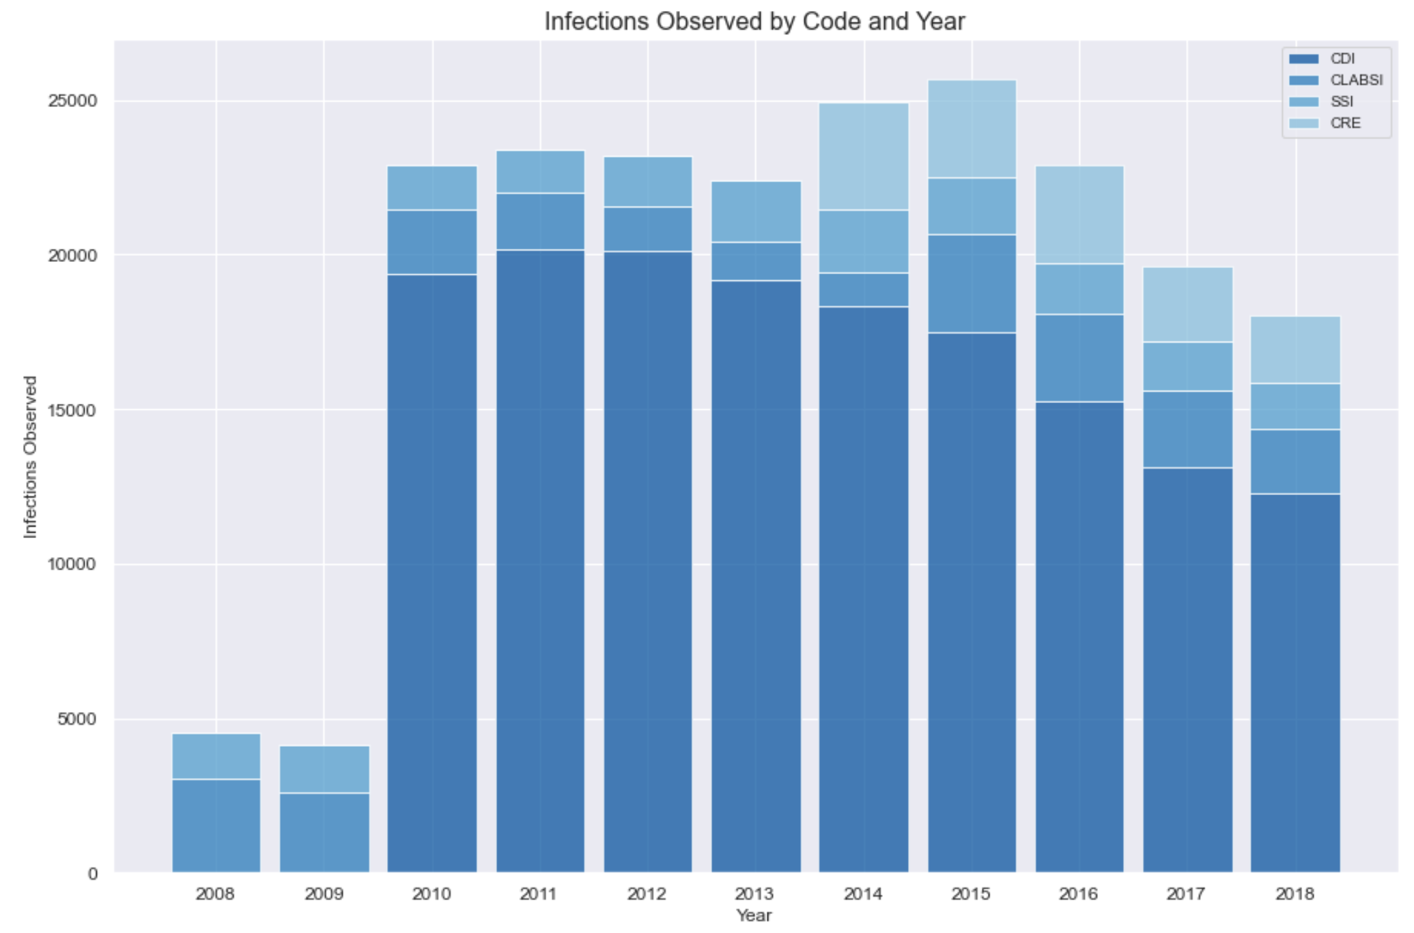
Data exploration
Why was there such a big jump in 2010?
CDI: Clostridium difficile infections
CLABSI: central line-associated blood stream infections
SSI: surgical site infections following colon, hip replacement/revision, coronary artery bypass graft, and hysterectomy
CRE: carbapenem-resistant Enterobacteriaceae infections
Notes:
I wanted to see if there was a particular type of infection causing the jump in 2010, so I broke down my bar chart by the indicator code – that’s basically the type of infection that was observed – and that revealed what was happening. CDI infections (the darkest blue) were first reported in 2010, and these appear to be fairly common. There is another, much smaller jump, in 2014, when CRE infections were first reported.

Slide 10
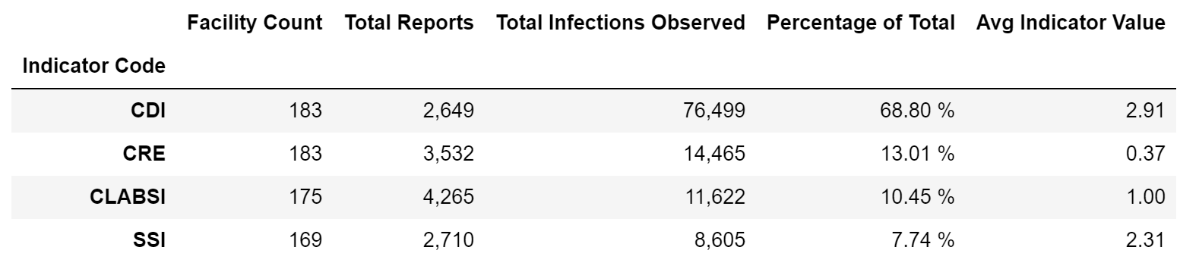
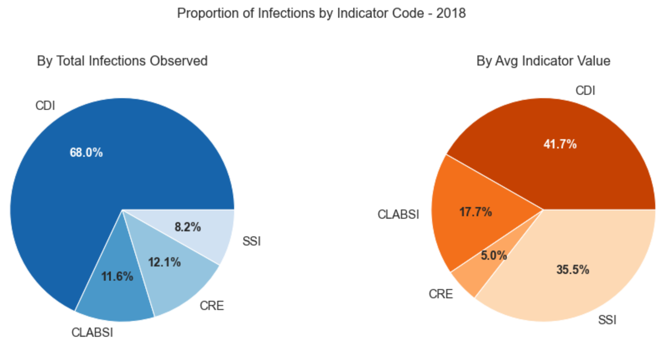
Data exploration
How do infection totals and incidence rates compare across the four indicator codes reported by NY facilities?
2014-2018
Notes:
I summarized the infection metrics by indicator code for 2014-2018, since these were the only years when all four indicator codes were reported.
Then I looked specifically at the most recent year in the dataset to see if the proportions of infections were consistent with the overall trend for 2014-2018, and they did seem to be.
The blue pie chart looks at the proportions for the number of total infections observed. The orange pie chart compares the average indicator values. The indicator values in the dataset are adjusted so they report the number of infections per a determined number of processes. For example, surgical site infections (SSI) indicator values are measured as the number of infections per 100 surgical procedures. So this metric gives a better measure of the infection incidence than the raw count. What I noticed in both the table and the pie charts was that while the number of SSI infections observed was the least of the indicator codes, its indicator value was disproportionately high.

Slide 11
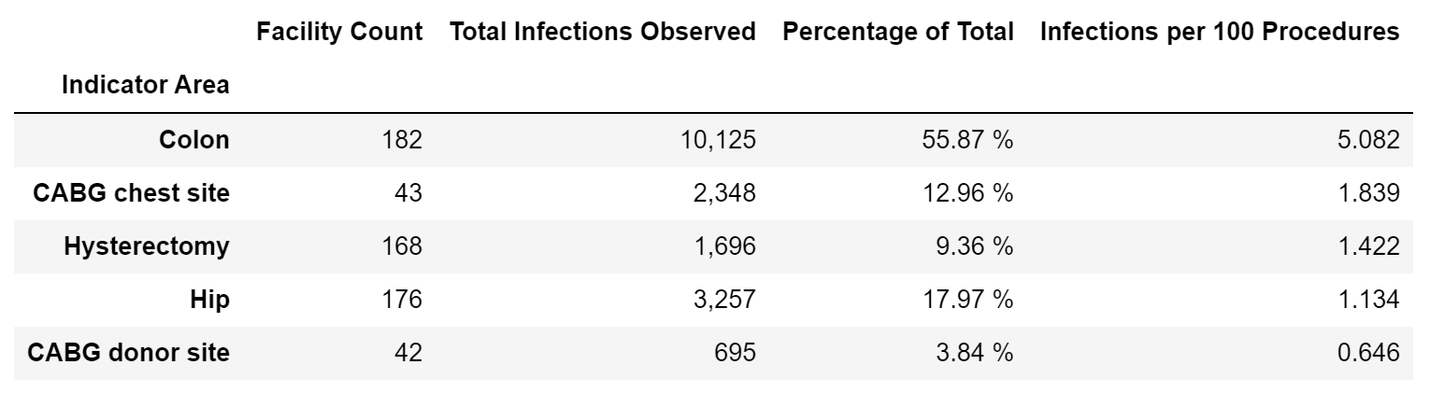
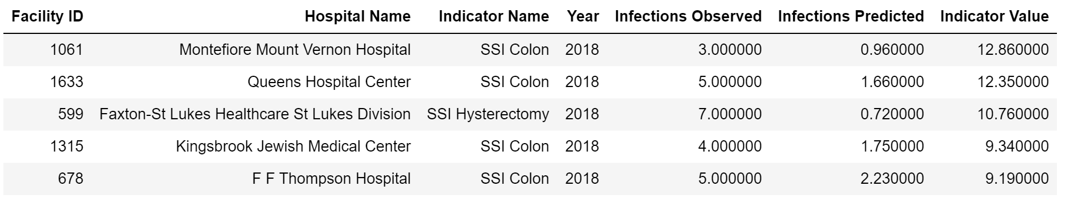
Data exploration
Which surgical procedures resulted in the highest infection rates from 2008-2018?
Which facilities had the highest SSI indicator values in 2018?
Notes:
Colon procedures come in first, whether you measure by total infection count or by the number of infections per 100 procedures.
I also checked the facilities with the highest SSI indicator values and 4 of the top 5 were related to colon procedures.
So that made me wonder, how do the indicator values for each code vary across facilities? Are all hospitals performing about the same on these measures within each code, or is there a lot of variability?

Slide 12
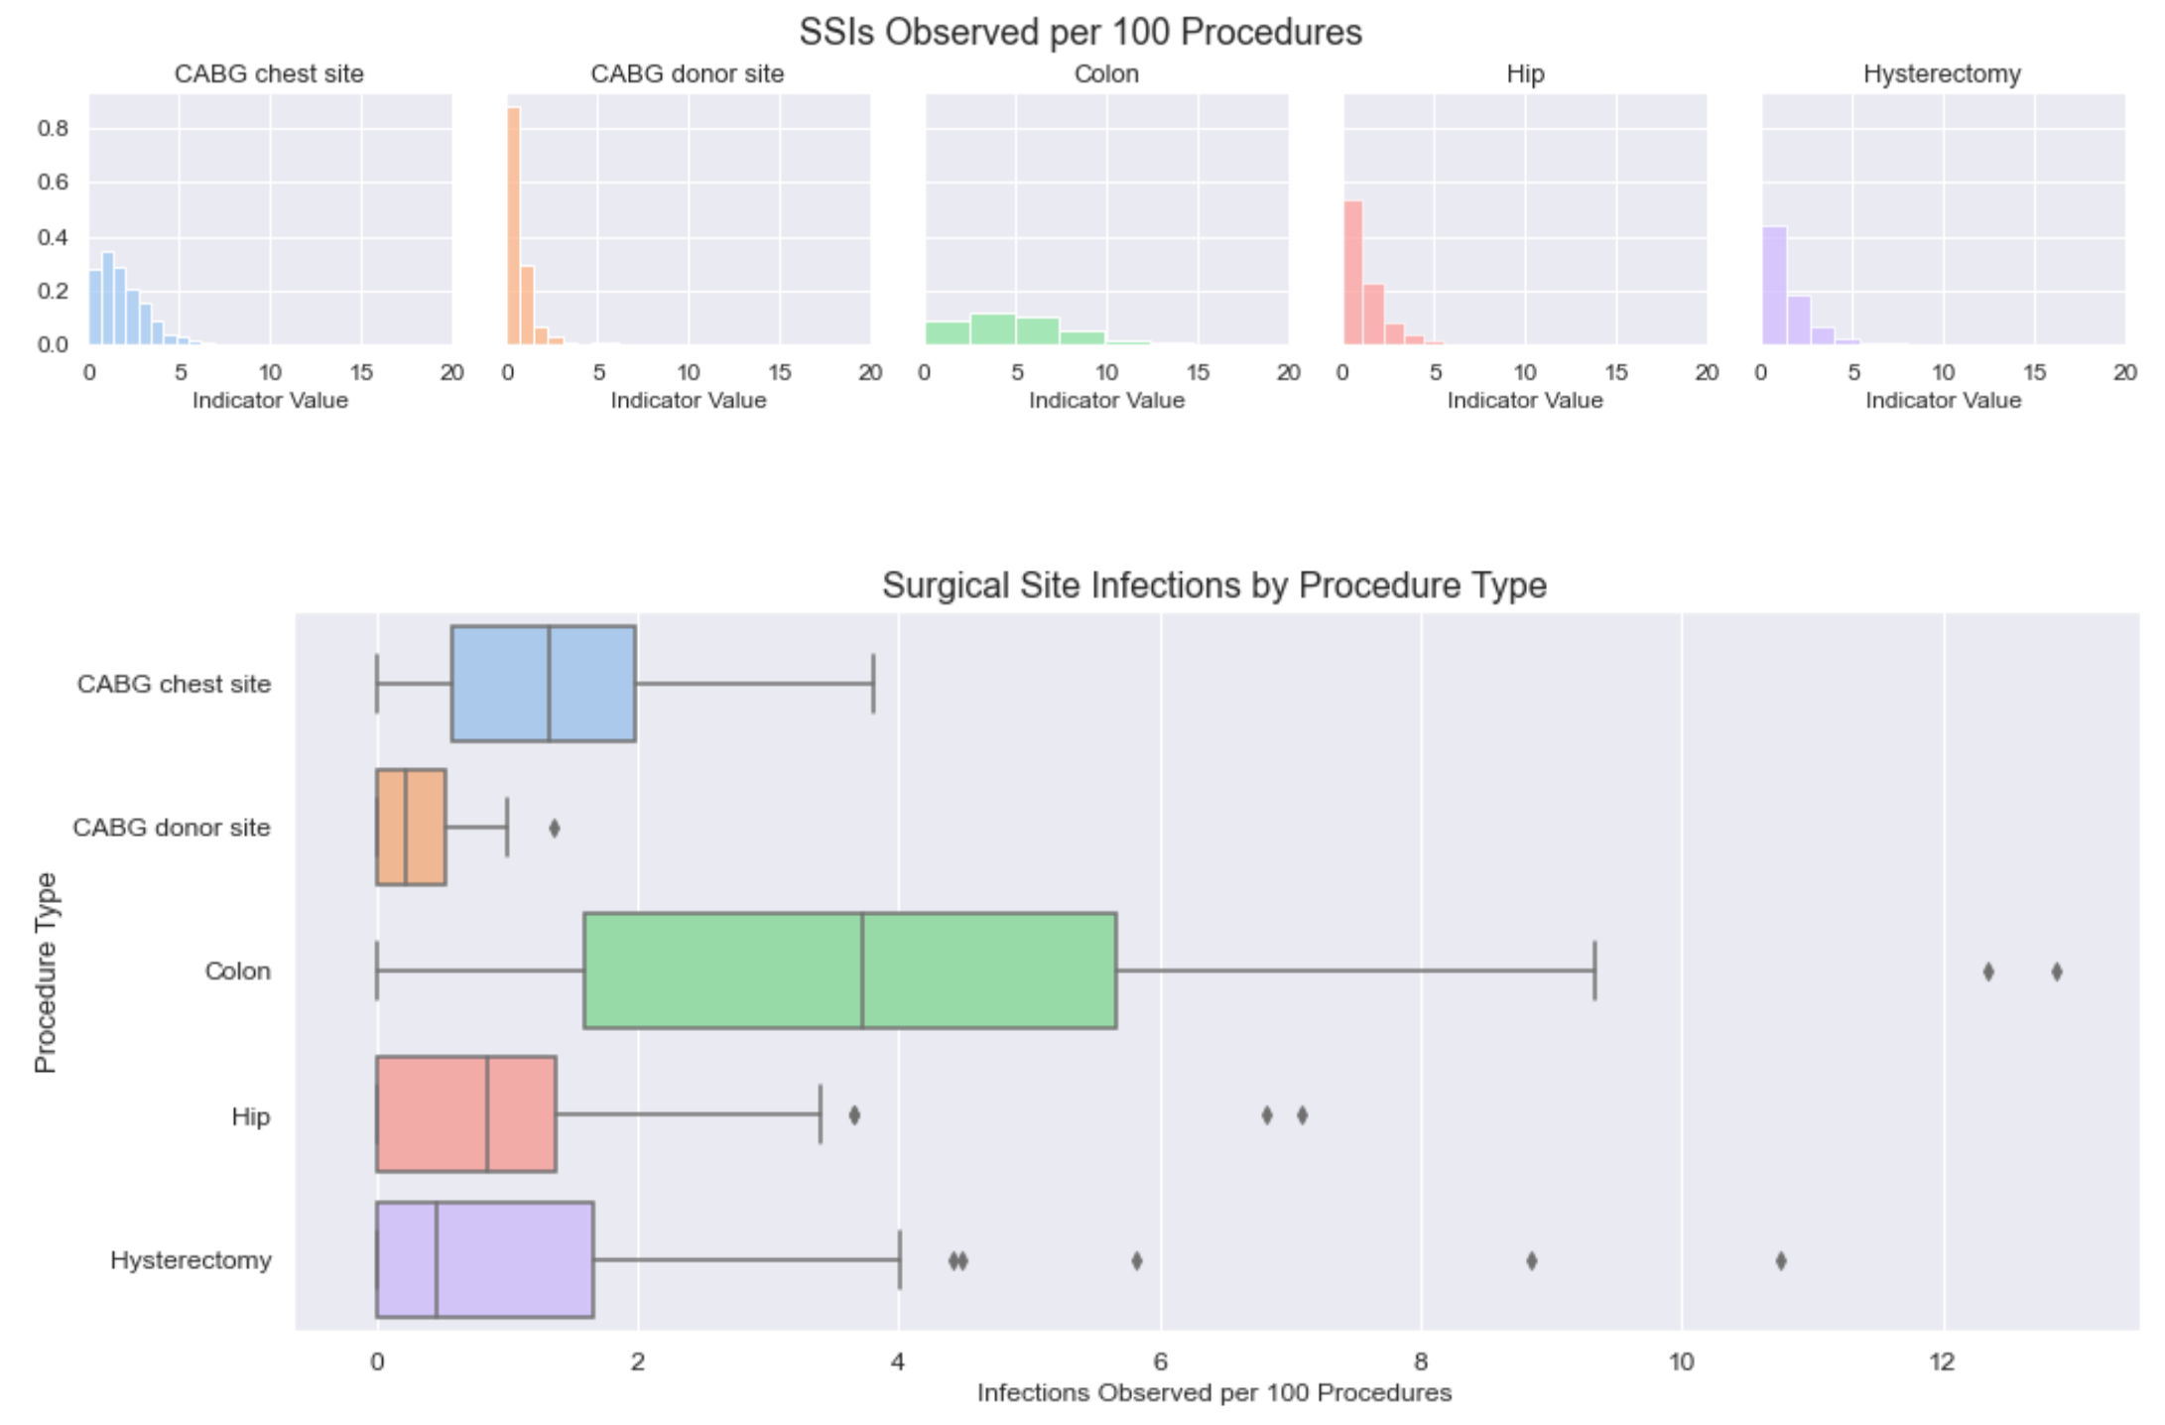
Data exploration
How do SSI indicator values vary across NY facilities for different surgical procedures?
Notes:
I created these histograms and box plots to compare the distribution of indicator values across the various facilities. They include 2008-2018.
Its clear that the shape of the Colon distribution is quite different than most of the other procedure types.
The “best” distribution looks like the CABG donor site (orange), where the vast majority of facilities have very low indicator values, and the bars taper off quickly. In comparison, the colon distribution is quite flat, and the whiskers on the box plot extend much further than the other procedure types.

Slide 13
Data discovery
Opportunity for Improvement
Because there is a high degree of variability in SSI indicator values for colon procedures across NY facilities, this may be an optimization opportunity.
If the best performing hospitals are studied to determine how they avoid SSI after colon procedures, perhaps more standardized processes can be developed and implemented at other hospitals to reduce SSI state-wide.

Slide 14
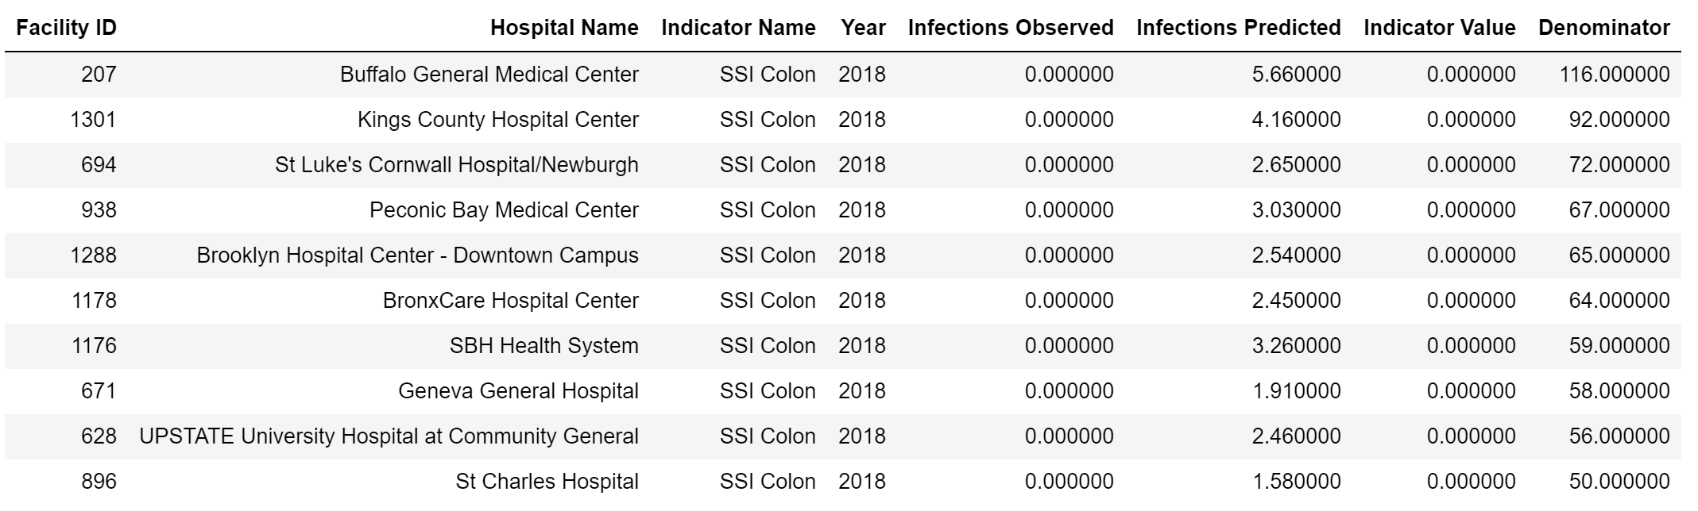
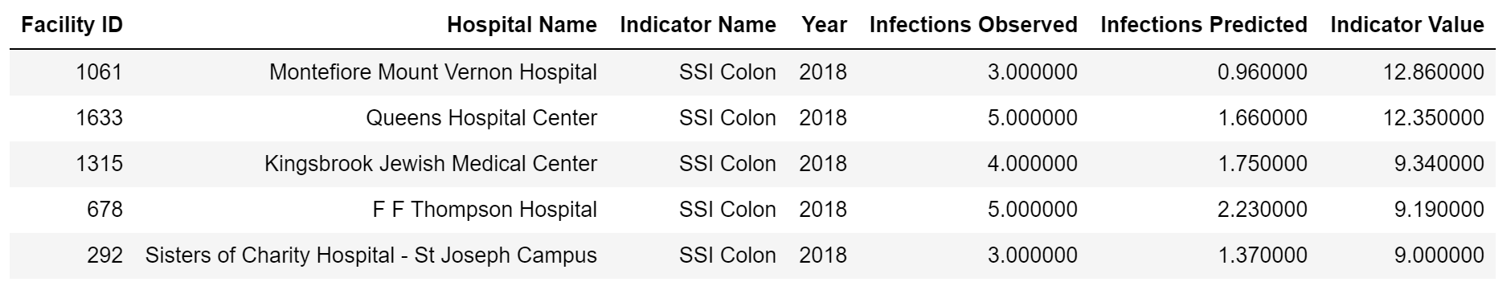
Data discovery
Which 10 hospitals should I study to develop standardized processes?
(Top 10 hospitals with the lowest SSI Colon indicator values for 2018)
Which 5 hospitals should I prioritize for optimization efforts?
(Top 5 hospitals with the highest SSI Colon indicator values for 2018)

Slide 15
summary
About 180 hospital facilities in NY reported annually on the number of hospital acquired infections observed within their facility between 2008 and 2018. The majority of these facilities are very near to or within the New York City metropolitan area.
Clostridium difficile infections (CDI) account for almost 70% of observed infections. Despite having a much smaller number of total infections, surgical site infections (SSI) have a relatively high incidence per 100 procedures.
There is a large variance in the incidence of SSI for Colon procedures across NY facilities. There may be opportunities here to study facilities with low SSI Colon incidences and develop standardized processes to limit variability. Facilities with high SSI Colon incidences can be prioritized for implementation of these processes.

Slide 16
Next steps
More data cleansing/exploratory data analysis
Better handling of missing values
Closer look at the indicator areas available for analysis
Stronger understanding of the metrics included, especially predicted infections and confidence bounds
More geographic analysis
Are there clusters of geographic areas where infection rates are particularly low or high?
Does this vary by the type of infection?
Focus in on the New York City metropolitan area
Get a shapefile for just this region so the preceding questions can be analyzed in more specific detail
Bring in demographic data – income, age, race, population density
Notes:
I ran out of time to analyze everything I would have liked to look into for this project, but here are some of my ideas for where I could go next.

Slide 17
discussion
Questions?
What are your thoughts?
What else would you like to see included?

Slide 18
Resources
RESOURCES
GitHub Repository
NY_Hospital_Acquired_Infections_2008-2018.ipynb
Datasets:
Hospital-Acquired_Infections__Beginning_2008.csv
NY_geo.csv (built from API data and exported to csv)
HAI_Data.csv (final dataset for analysis)
Python libraries used:
For data analysis: numpy, pandas, pprint
For visualization: matplotlib, seaborn
For API calls: requests, urllib, time
For mapping: os, shapefile, geopandas, shapely, citipy
For shapefiles: us
Notes:
The us module was not compatible with geopandas, so I only used it to download the shapefile for New York State. The shapefile is available from the GitHub repo.

Slide 19
Thank you!

